Slide 1
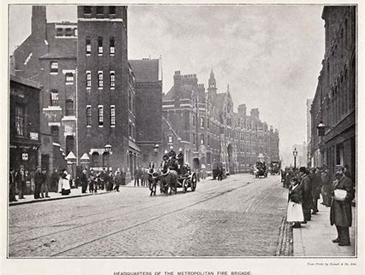
Year 6 Computing
Spring 1
Aims: To plan, design and create an app about Victorian London.
KS1 National Curriculum Coverage
-Understand computer networks, how they provide multiple services (www) and the opportunities and collaboration.
-Work with various forms of input and output.
-Use search technologies effectively, appreciate how results are selected and ranked, and be discerning in evaluating digital content.
Resources:
Laptops, LGFL app maker software, student login details, information about Victorian London, Topic books, paper and pencils.

Slide 2
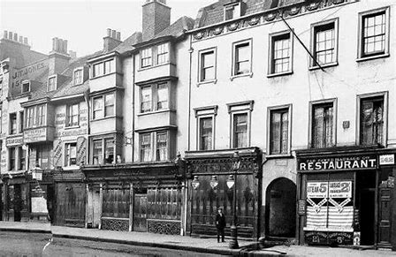
Instructions:
Pupils are placed into small groups. They must then plan the information they will put on the app using the story board planning sheet (4/6 square). In each square they must draw and label what the page will look like and colour the background. After the planning is completed in detail and approved by the class teacher the children will begin to create their Victorian London app by organising their information into groups, (clothing, school, food, games, etc).
Once all the writing is organised they will begin to design their app using their story board. Children must listen carefully to each other and communicate as a team in order to ensure quality results. They will complete the creating step by logging onto the LGFL and opening up the ‘App Maker’ software.
Extension:
Pupils can be challenged to create a Victorian London quiz by using the same software.

