Slide 1
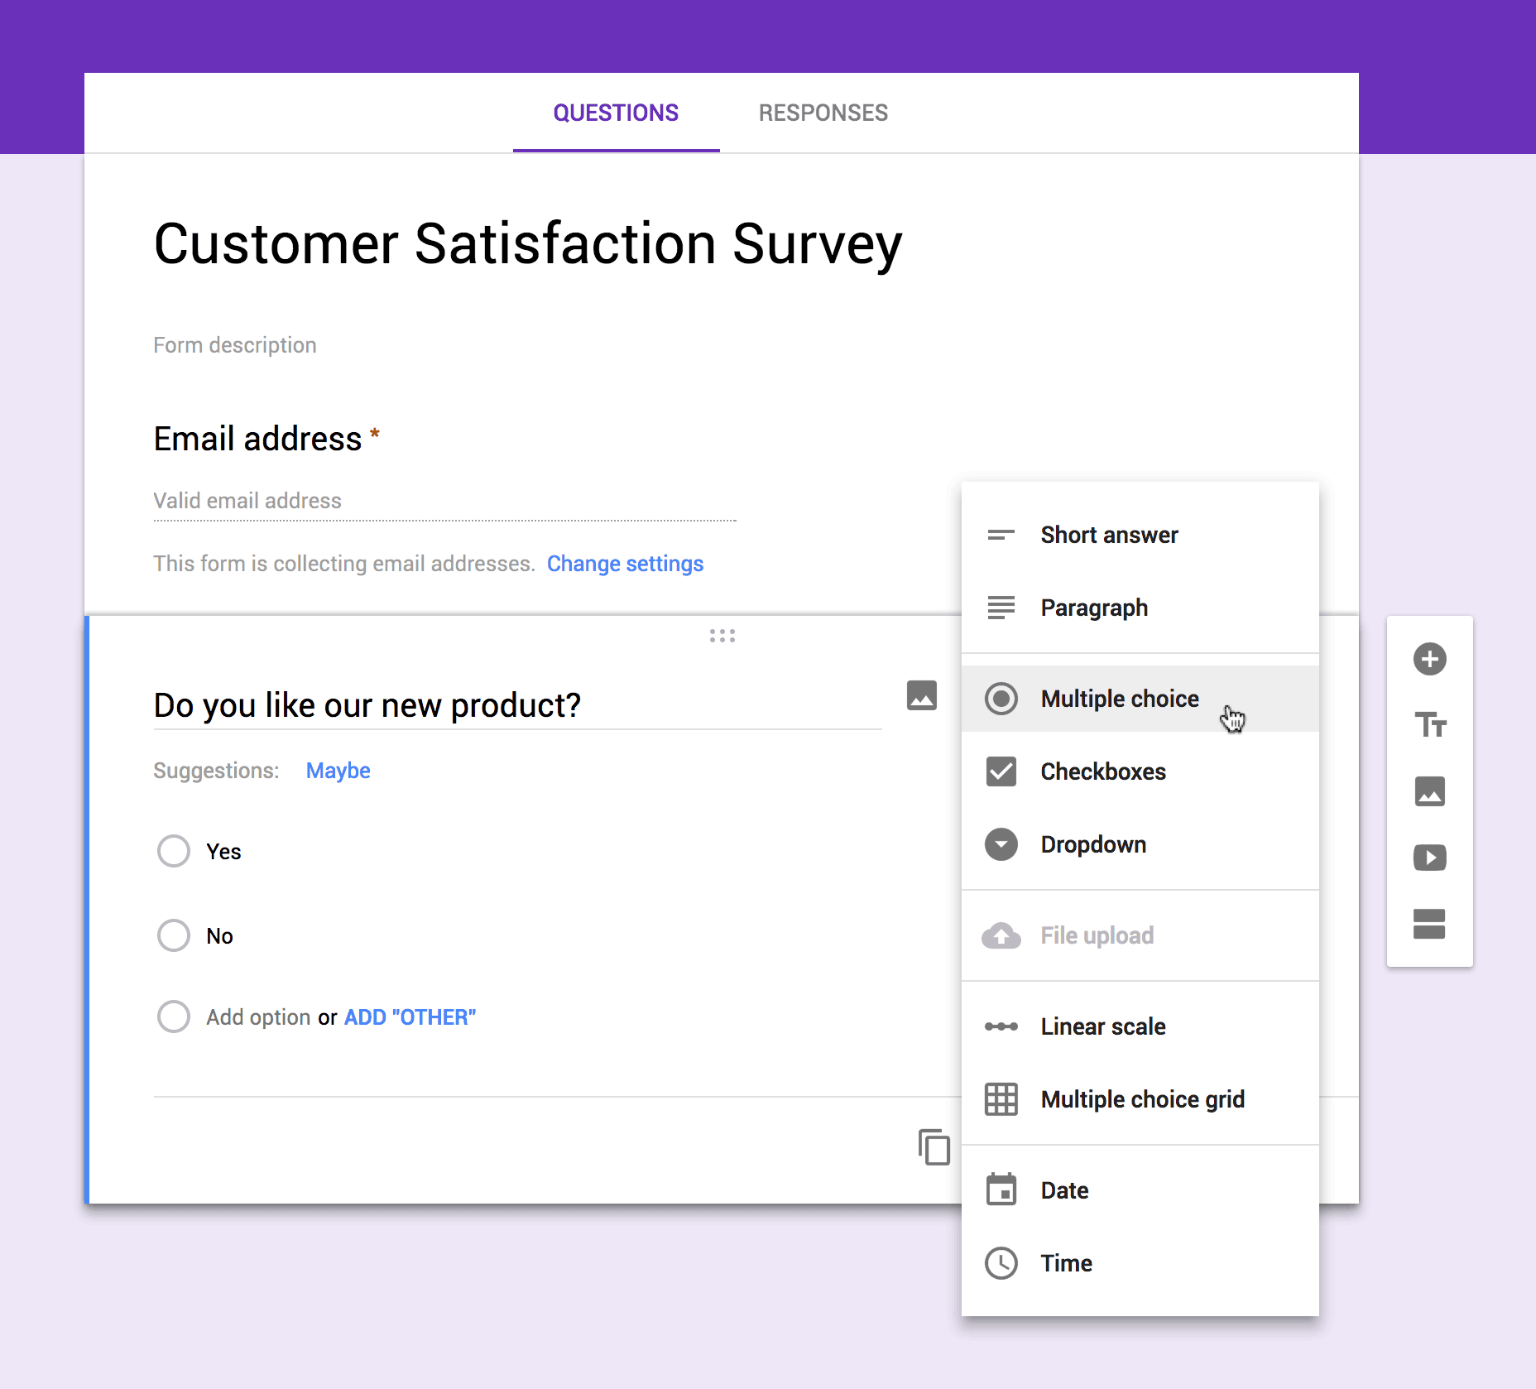
Year 3 Computing
Spring 1
Aims: To create a survey to help them gather data.
KS1 National Curriculum Coverage
-Use logical reasoning to explain how simple algorithms work and to detect and correct errors in algorithms and programs.
-Create a range of programs, systems and contents to accomplish given goals that include: collecting, analysing, evaluating and presenting data and information.
Resources:
Learnpads, word bank, webrowser, google forms, google sheets and google slides.

Slide 2
Lesson 1 Instructions:
Explain that surveying is about asking questions. One big question and then splitting that big question up into lots of smaller questions to help you find the answer to the bigger question.
For example: Does everyone at Ivydale like chocolate?
If we just asked people this question they would just give an opinion based on what they see happening. But they might be wrong as they only see their own family and friends. We will get closer to the truth by asking lots of people and splitting the question up into smaller chunks.
Look at the question and find the key elements. I have highlighted them in Yellow.
From this question I might ask the following smaller related questions.
· Have you ever eaten chocolate?
· How often do you eat chocolate? Once, Twice, every day, twice a day, more than twice a day.
Explain how each question relates to part of the highlighted sentence either age or how much they use a computer.
Explain that it is important to give possible answers as you can then graph the results.
Now post this or another question and give the children time in pairs to formulate verbally smaller questions. Demonstrate how we can create a Google Form with some of their questions in it. Stick to multiple choice and text question fields to start with.
Give them time to create their own simple survey. Show them how they can email this to friends in the class. If time, fill in each others and see where the results turn up.

Slide 3
Lesson 2 Instructions:
Briefly explain the two options at the top. Explain that the second option is good if you want to know who is filling in your survey however ask pupils if they can think of any times when it might be better to get people to fill in a survey anonymously?
During this discussion it is worth saying that it is never acceptable to create surveys about people we know as this could be a form of cyber bullying.
Go over the naming and notes box at the top of the form.
Now create a simple question using the drop down option box in the top left.
Show pupils how to edit a question already created and how to drag and drop a question to change its order.
Give pupils lots of time to create a basic survey based around questions created in lesson one. Half way through the session, stop pupils and show them the grid and scale type questions. Demonstrate this using a question that asks someone to express a preference. Ten minutes before the end of the session show pupils how they can email this to other pupils within the school. If pupils have finished their surveys they can fill in other people’s surveys.

Slide 4
Lesson 3 Instructions:
Give pupils at least 15 minutes to fill in as many surveys as they can. Whilst they are doing this remind them that their results will be more accurate if more people respond. 10 responses will be more accurate and more closely resemble what the majority think than 5 and 100 will be even more accurate.
Show pupils how the results are all collected in the spread sheet view.
Explain that it is very important that we don’t change our questions once users have started to fill the survey in or we will break the form. (You can create a copy of the spread sheet if you wish to work directly on the results)
Now show pupils how we can view the summary of responses. If you are doing this with a younger group of children I would spend some time getting them to interpret some of the graphs through simple higher or lower value questions.
Now choose one pupils survey and model writing a report that sticks to the facts. Try a simple sentence explaining what each graph means. Try and draw a conclusion at the end if the data lets you.
Now give pupils time to write a report on their data. You could get them to do this on Google docs and share with you, on Word or in their books.
Explain to pupils that it is this work that you will be used to assess their survey understanding.
At the end of the lesson challenge pupils to see if they can find a surveying opportunity within the wider curriculum. If they can find an opportunity they can pursue it with a friend.

