Slide 1
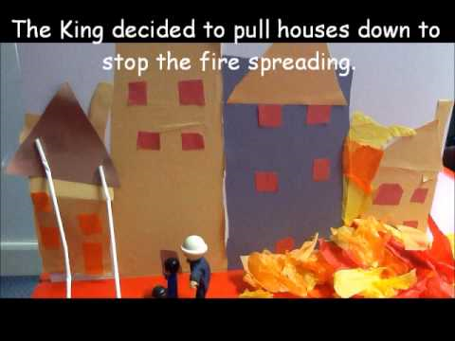
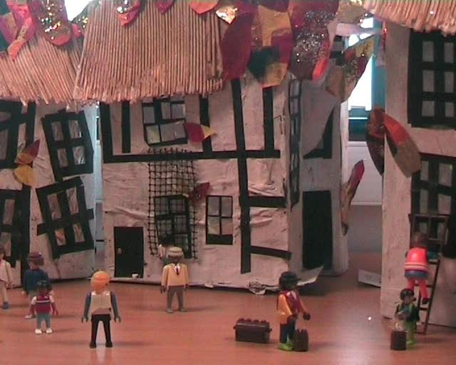
Year 2 Computing
Spring 1
Aims: To plan, create and film the story of the Great Fire of London.
KS1 National Curriculum Coverage
-Common use of I.T.
-Identify where to go for help and support.
-Use technology purposefully to create, organise.
-Store, manipulate and retrieve digital content.
Resources:
Learn-Pads, camera, stop-motion animation, plasticine, wire, coloured pencils, paper, planning sheets.

Slide 2
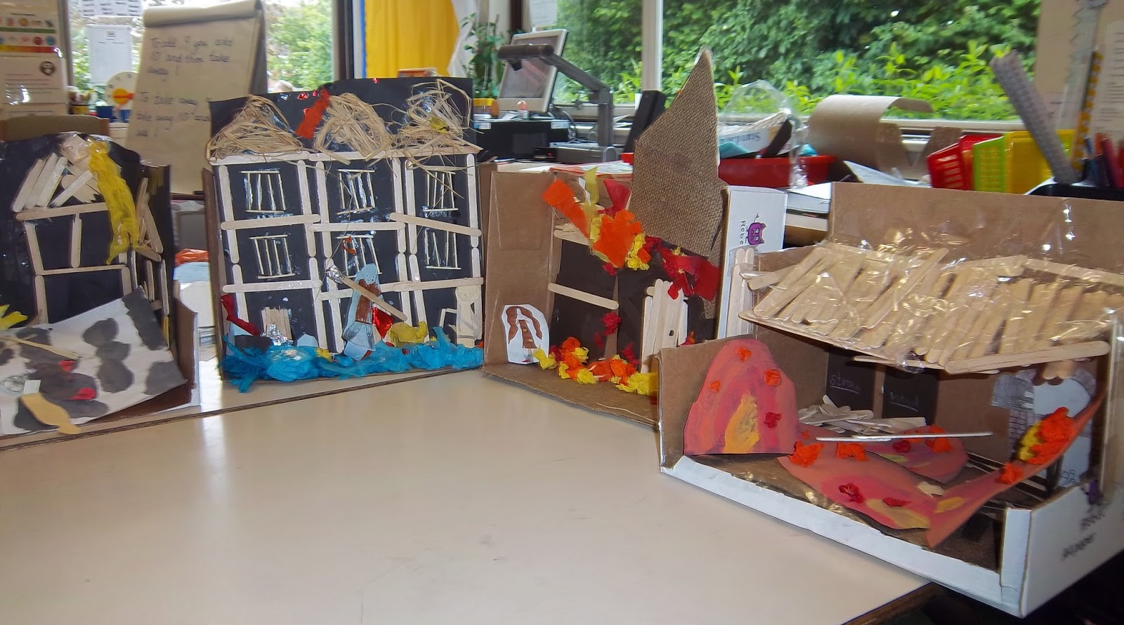
Instructions:
Pupils are placed into small groups. They must then plan their story using the story board planning sheet (6/8 squares). In each square they must draw and label their characters, background and how the characters and objects will move, etc. After the planning is completed in detail and approved by the class teacher the children will begin to create their characters, background, objects, etc.
Once all the materials are created they can start to film their story following their story board. Children must listen carefully to each other and communicate as a team in order to ensure quality images (no hands in the pictures). Once the children are finished filming they will edit their work together.
Extension:
Pupils can be challenged to create the story from different perspectives or create a voiceover. If they create a voiceover then they will need write a script using the topic books available in the classroom as support.

