Slide 1
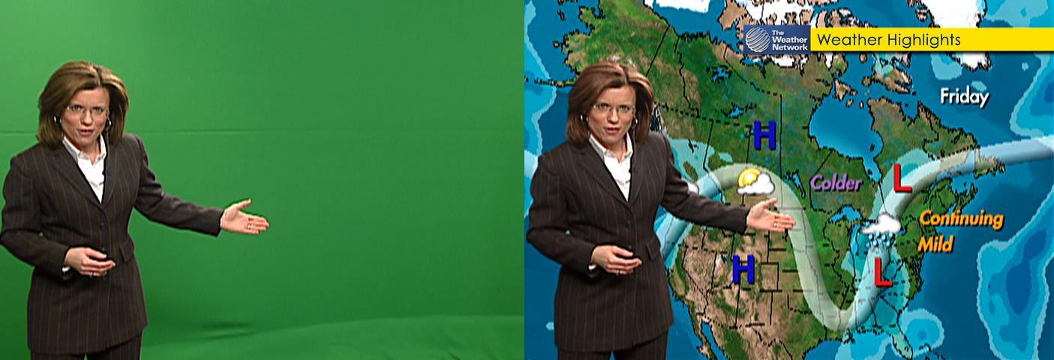
Year 5 Computing
Spring 1
Aims: To write and film a news segment about natural disasters and climate change.
KS1 National Curriculum Coverage
-Create a range of programs, systems and contents to accomplish given goals that include: collecting, analysing, evaluating, and presenting data and information.
-Work with variables and various forms of input and output.
Resources:
iPads, laptops, camera, green screen, web browser, example weather scripts and word banks.

Slide 2
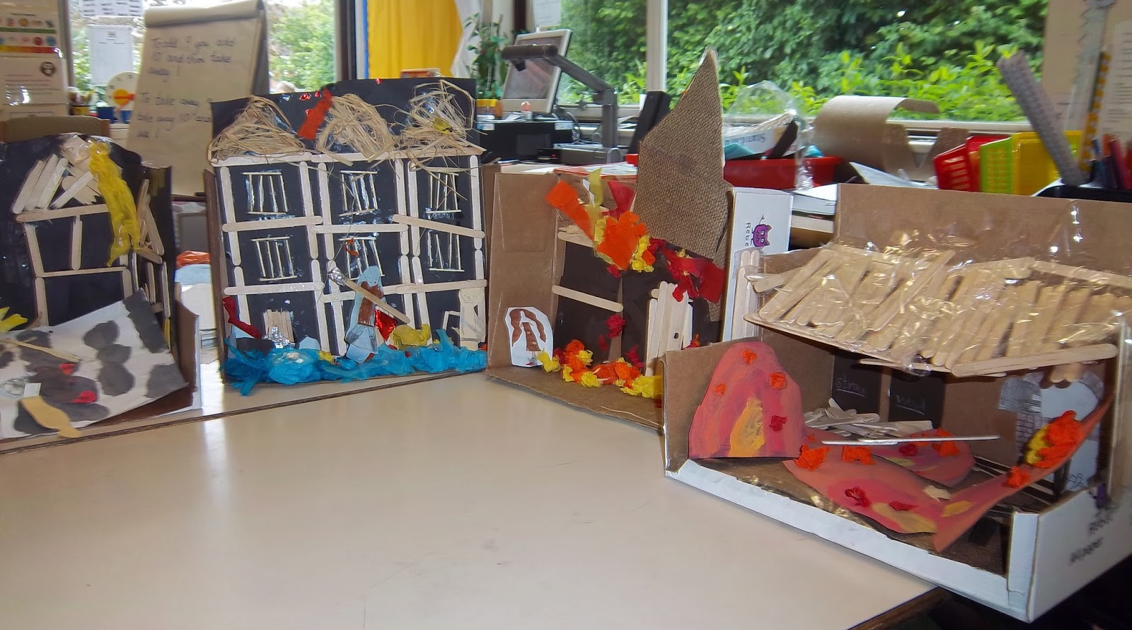
Instructions:
Pupils are placed into groups. They must then plan their script using the story board planning sheet (6/8 squares). In each square they must draw and label the news anchors, background and how the news anchors and background will move, etc. After the planning is completed in detail and approved by the class teacher the children will begin to write the script for the news anchors and choose the necessary background, etc.
Once all the materials are created they can start to film their news program following their story board. Children must listen carefully to each other and communicate as a team in order to ensure quality videos (not shaky and no background bodies). Once the children are finished filming they will edit their work together.
Extension:
Pupils can be challenged to include an interview. If they create an interview they can choose a different background and write key questions that their interviewee will need to answer. They can use the topic books available in the classroom as support.

